Slide 1
BLOCK 2

Slide 2
Understanding Descriptive Analysis
When we try to represent data in the form of graphs, like histograms, line plots, etc. the data is represented based on some kind of central tendency. Central tendency measures like, mean, median, or measures of the spread, etc are used for statistical analysis.
To better understand Statistics lets discuss the different measures in Statistics with the help of an example.

Slide 3
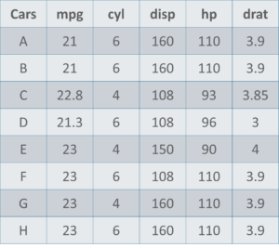
Understanding Descriptive Analysis

Slide 4
Understanding Descriptive Analysis
Here is a sample data set of cars containing the variables:
Cars
Mileage per Gallon (mpg)
Cylinder Type (cyl)
Displacement (disp)
Horse Power (hp)
Real Axle Ratio (drat).
Before we move any further, let’s define the main Measures of the Center or Measures of Central tendency.

Slide 5
Understanding Descriptive Analysis
Measures Of The Center
Mean: Measure of average of all the values in a sample is called Mean.
Median: Measure of the central value of the sample set is called Median.
Mode: The value most recurrent in the sample set is known as Mode.
Using descriptive Analysis, you can analyse each of the variables in the sample data set for mean, standard deviation, minimum and maximum.
If we want to find out the mean or average horsepower of the cars among the population of cars, we will check and calculate the average of all values. In this case, we’ll take the sum of the Horse Power of each car, divided by the total number of cars:
Mean = (110+110+93+96+90+110+110+110)/8 = 103.625

Slide 6
Understanding Descriptive Analysis
If we want to find out the centre value of mpg among the population of cars, we will arrange the mpg values in ascending or descending order and choose the middle value. In this case, we have 8 values which is an even entry. Hence we must take the average of the two middle values.
The mpg for 8 cars: 21,21,21.3,22.8,23,23,23,23 Median = (22.8+23 )/2 = 22.9
If we want to find out the most common type of cylinder among the population of cars, we will check the value which is repeated most number of times. Here we can see that the cylinders come in two values, 4 and 6. Take a look at the data set, you can see that the most recurring value is 6. Hence 6 is our Mode.

Slide 7
Understanding Descriptive Analysis
Measures of the Spread
Just like the measure of center, we also have measures of the spread, which comprises of the following measures:
Range: It is the given measure of how spread apart the values in a data set are.
Inter Quartile Range (IQR): It is the measure of variability, based on dividing a data set into quartiles.
Variance: It describes how much a random variable differs from its expected value. It entails computing squares of deviations.
Deviation is the difference between each element from the mean.
Population Variance is the average of squared deviations
Sample Variance is the average of squared differences from the mean
Standard Deviation: It is the measure of the dispersion of a set of data from its mean.
Now that we’ve seen the stats and math behind Descriptive analysis

Slide 8
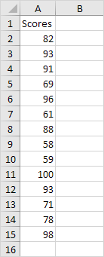
Descriptive Statistics in Excel
You can use the Analysis ToolPak add-in to generate descriptive statistics. For example, you may have the scores of 14 participants for a test.

Slide 9
Descriptive Statistics in Excel
To generate descriptive statistics for these scores, execute the following steps.

Slide 10
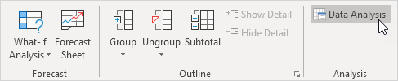
Descriptive Statistics in Excel
1. On the Data tab, in the Analysis group, click Data Analysis.
Note: can't find the Data Analysis button? Click here to load the Analysis ToolPak add-in

Slide 11
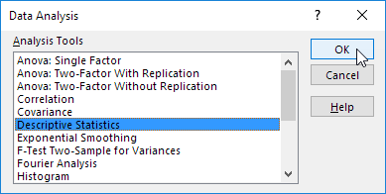
Descriptive Statistics in Excel
2. Select Descriptive Statistics and click OK.

Slide 12
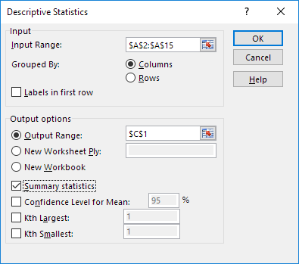
Descriptive Statistics in Excel
3. Select the range A2:A15 as the Input Range.
4. Select cell C1 as the Output Range.
5. Make sure Summary statistics is checked.

Slide 13
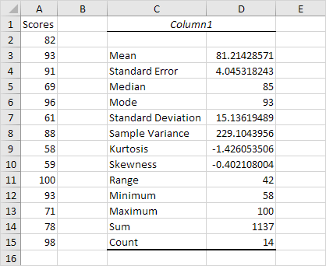
Descriptive Statistics in Excel
6. Click OK.
Result:

Slide 14
Descriptive Statistics in Excel
Statistic | Description
Mean | Shows the arithmetic mean of the sample data.
Standard Error | Shows the standard error of the data set (a measure of the difference between the predicted value and the actual value).
Median | Shows the middle value in the data set (the value that separates the largest half of the values from the smallest half of the values).
Mode | Shows the most common value in the data set.
Standard Deviation | Shows the sample standard deviation measure for the data set.
Sample Variance | Shows the sample variance for the data set (the squared standard deviation).
Kurtosis | Shows the kurtosis of the distribution.
Skewness | Shows the skewness of the data set’s distribution.

Slide 15
Descriptive Statistics in Excel
Range | Shows the difference between the largest and smallest values in the data set.
Minimum | Shows the smallest value in the data set.
Maximum | Shows the largest value in the data set.
Sum | Adds all the values in the data set together to calculate the sum.
Count | Counts the number of values in a data set.
Largest(X) | Shows the largest X value in the data set.
Smallest(X) | Shows the smallest X value in the data set.
Confidence Level(X) Percentage | Shows the confidence level at a given percentage for the data set values.

